Slide 1
Naïve Bayes Classifier
Lin zhang
Sse, tongji university
Sep. 2016

Slide 2
Background
There are two methods to establish a classifier
  a) Model a classification rule directly
  Examples: k-NN, decision trees, BP neural network, SVM
  b) Make a probabilistic model of data within each class
  Examples: naive Bayes, model based classifiers
a) are examples of discriminative classification
b) is an example of generative classification

Slide 3
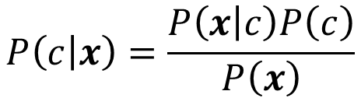
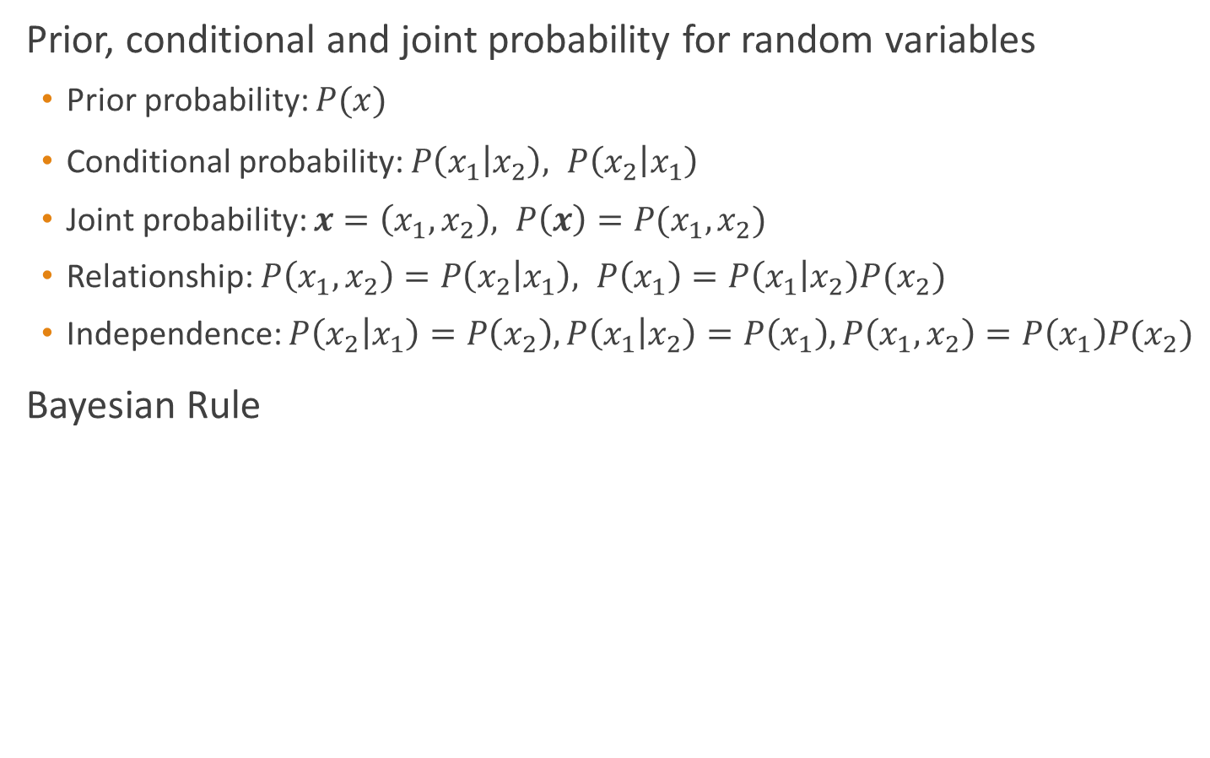
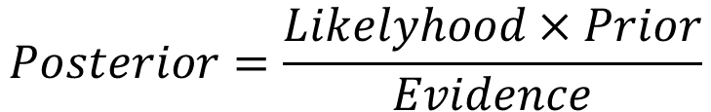
Probability Basics
Prior, conditional and joint probability for random variables
  Prior probability: $P(x)$
  Conditional probability: $P\left(x_{1} | x_{2}\right), P\left(x_{2} | x_{1}\right)$
  Joint probability: $x=\left(x_{1},x_{2}\right), P\left(x\right)=P(x_{1},x_{2})$
  Relationship: $P\left(x_{1},x_{2}\right)=P\left(x_{2} | x_{1}\right), P\left(x_{1}\right)=P\left(x_{1} | x_{2}\right)P(x_{2})$
  Independence: $P\left(x_{2} | x_{1}\right)=P\left(x_{2}\right),P\left(x_{1} | x_{2}\right)=P\left(x_{1}\right), P\left(x_{1},x_{2}\right)=P\left(x_{1}\right)P(x_{2})$
Bayesian Rule
$$P\left(c | x\right)=\frac{P\left(x | c\right)P\left(c\right)}{P\left(x\right)}$$
$$Posterior=\frac{Likelyhood×Prior}{Evidence}$$
Discriminative
Generative

Slide 4
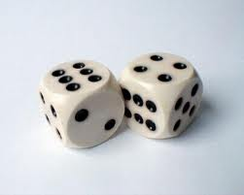
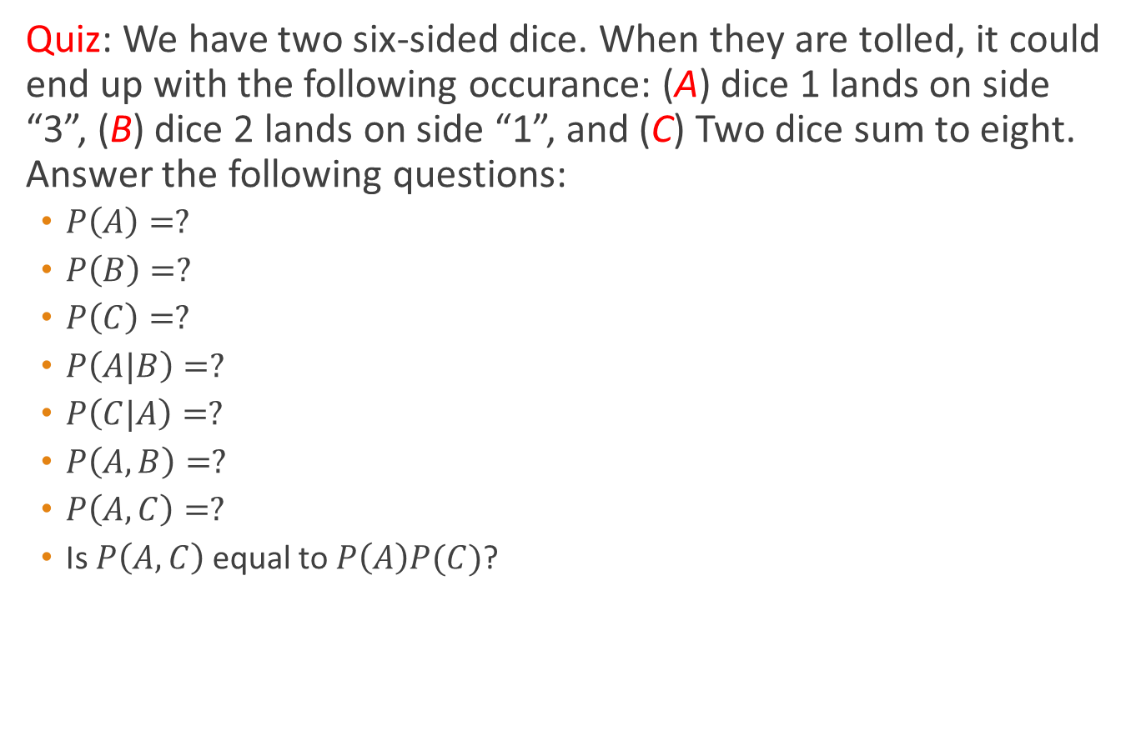
Probability Basics
Quiz: We have two six-sided dice. When they are tolled, it could end up with the following occurance: (A) dice 1 lands on side “3”, (B) dice 2 lands on side “1”, and (C) Two dice sum to eight. Answer the following questions:
  $P\left(A\right)=?$
  $P\left(B\right)=?$
  $P\left(C\right)=?$
  $P\left(A|B\right)=?$
  $P\left(C|A\right)=?$
  $P\left(A,B\right)=?$
  $P\left(A,C\right)=?$
  Is $P\left(A,C\right)$ equal to $P\left(A\right)P(C)$?
Notes:
P(A)=1/6 P(B)=1/6 P(C)=1/6*1/6*7=7/36 P(A|B)=1/6 P(C|A)=1/6 P(A,B)=1/6*1/6=1/36 P(A,C)=1/6*1/6=1/36

Slide 5



Probabilistic Classification
Establishing a probabilistic model for classification
  Discriminative model
$$P\left(c | x\right) c=c_{1},…,c_{L}, x=(x_{1},…,x_{d})$$
To train a discriminative classifier regardless its probabilistic or non-probabilistic nature, all training examples of different classes must be jointly used to build up a single discriminative classifier.
Output $L$ probabilities for $L$ class labels in a probabilistic classifier while a single label is achieved by a non-probabilistic classifier .
Discriminative
Probabilistic Classifier
$$x_{d}$$
$$x=(x_{1},x_{2},…,x_{d})$$

Slide 6


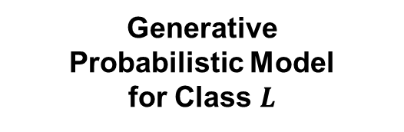



Probabilistic Classification
Establishing a probabilistic model for classification
  Generative model (must be probabilistic)
$$P\left(c | x\right) c=c_{1},…,c_{L}, x=(x_{1},…,x_{n})$$
$L$probabilistic models have to be trained independently
Each is trained on only the examples of the same label
Output $L$ probabilities for a given input with $L$ models
“Generative” means that such a model produces data subject to the distribution via sampling.
Generative
Probabilistic Model
for Class $1$
Generative
Probabilistic Model
for Class $L$
$$x_{d}$$
$$x_{d}$$
$$x=(x_{1},x_{2},…,x_{d})$$

Slide 7
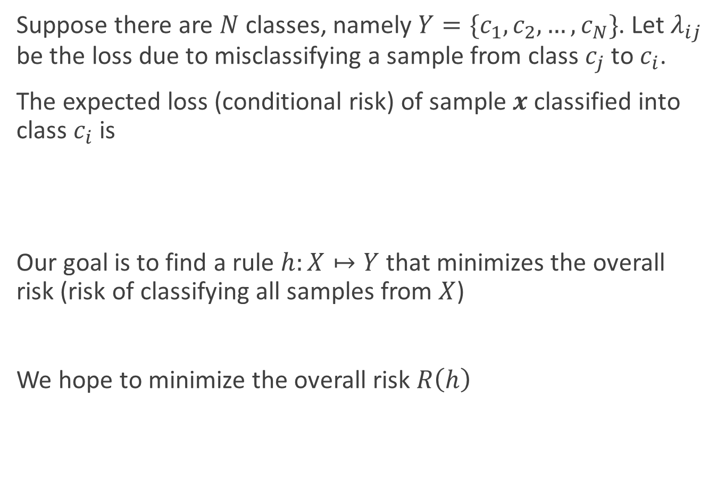
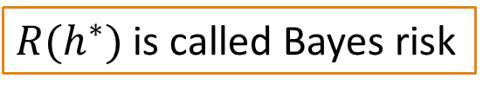



Bayesian decision theory
Suppose there are $N$ classes, namely $Y=\{c_{1},c_{2},…,c_{N}\}$. Let $λ_{ij}$ be the loss due to misclassifying a sample from class $c_{j}$ to $c_{i}$.
The expected loss (conditional risk) of sample $x$ classified into class $c_{i}$ is
Our goal is to find a rule $h:X↦Y$ that minimizes the overall risk (risk of classifying all samples from $X$)
We hope to minimize the overall risk $R\left(h\right)$
$$R\left(c_{i} | x\right)=\sum_{j=1}^{N}{λ_{ij}P(c_{j}|x)}$$
$$R\left(h\right)=𝔼_{x}\left[R(h(x)|x)\right]$$
$$h^{∗}\left(x\right)=\arg{\min_{c∈Y}{R(c|x)}}$$
Bayesian optimal classifier
$R(h^{∗})$ is called Bayes risk
Notes:
对分类任务来说，在所有相关概率都已知的立项情形下，贝叶斯决策论考虑如何基于这些概率和误判损失来选择最优的类别标记

Slide 8

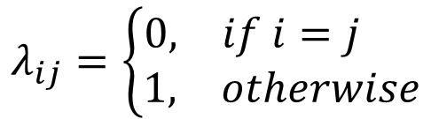

Bayesian decision theory
If
Then
Bayesian optimal classifier
$$λ_{ij}=\left\{\begin{matrix}\begin{matrix}0, & if i=j \end{matrix} \\ \begin{matrix}1, & otherwise\end{matrix}\end{matrix}\right.$$
$$R\left(c | x\right)=1−P(c|x)$$
$$h^{∗}\left(x\right)=\arg{\max_{c∈Y}{P(c|x)}}$$

Slide 9
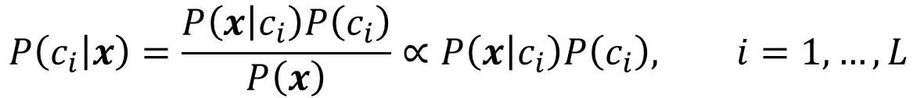
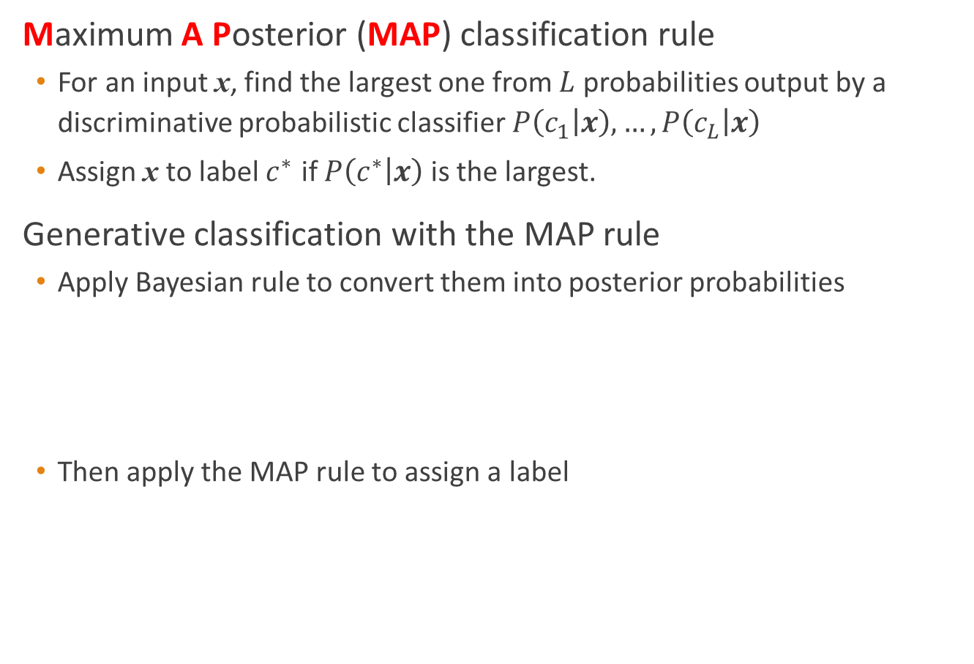
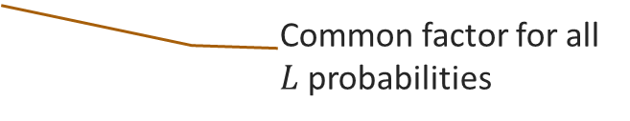
Probabilistic Classification
Maximum A Posterior (MAP) classification rule
  For an input x, find the largest one from $L$ probabilities output by a discriminative probabilistic classifier $P\left(c_{1} | x\right),…,P\left(c_{L} | x\right)$
  Assign x to label $c^{∗}$ if $P\left(c^{∗} | x\right)$ is the largest.
Generative classification with the MAP rule
  Apply Bayesian rule to convert them into posterior probabilities
  Then apply the MAP rule to assign a label
$$P\left(c_{i} | x\right)=\frac{P\left(x | c_{i}\right)P\left(c_{i}\right)}{P\left(x\right)}∝P\left(x | c_{i}\right)P\left(c_{i}\right), i=1,…,L$$
Common factor for all $L$probabilities

Slide 10
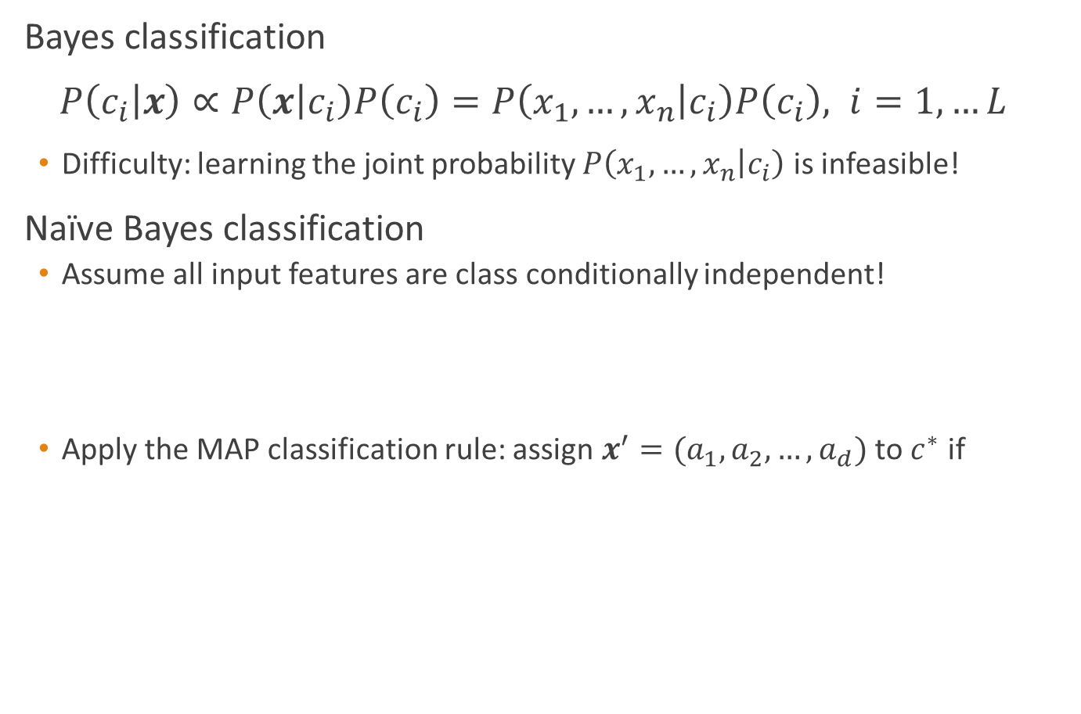
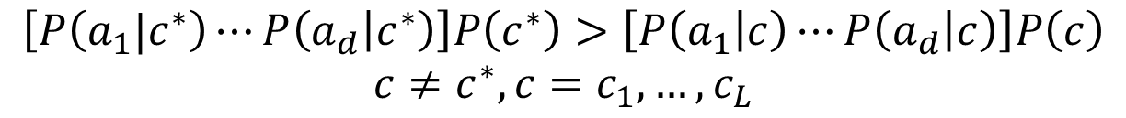
Naïve Bayes classifier
Bayes classification
$P\left(c_{i} | x\right)∝P\left(x | c_{i}\right)P\left(c_{i}\right)=P\left(x_{1},…,x_{n} | c_{i}\right)P\left(c_{i}\right), i=1,…L$
  Difficulty: learning the joint probability $P\left(x_{1},…,x_{n} | c_{i}\right)$ is infeasible!
Naïve Bayes classification
  Assume all input features are class conditionally independent!
  Apply the MAP classification rule: assign $x^{′}=(a_{1},a_{2},…,a_{d})$ to $c^{∗}$ if
$$P\left(x_{1},…,x_{n} | c_{i}\right)=P\left(x_{1} | c_{i}\right)P(x_{2}|c_{i})⋯P(x_{d}|c_{i})$$
$$\left[P\left(a_{1}|c^{∗}\right)⋯P\left(a_{d} | c^{∗}\right)\right]P\left(c^{∗}\right)>\left[P\left(a_{1} | c\right)⋯P\left(a_{d} | c\right)\right]P\left(c\right)$$
$$c≠c^{∗}, c=c_{1},…,c_{L}$$

Slide 11
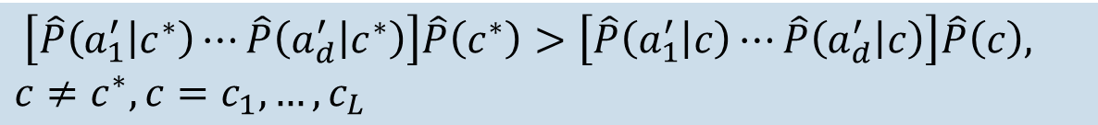

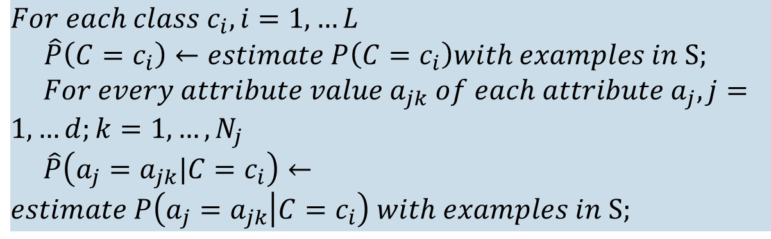
Naïve Bayes Algorithm
Naïve Bayes Algorithm (for discrete input attributes) has two phases
  1. Learning Phase: Given a training set $S$,
Output: conditional probability tables; for $x_{j}$, $N_{j}×L$ elements
  2. Test Phase: Given an unknown instance $x^{′}=[a_{1}^{′},a_{2}^{′},…,a_{d}^{′}]$,
Look up tables to assign the label $c^{∗}$ to $x^{′}$ if
Learning is easy, just create probability tables.
$$For each class c_{i}, i=1,…L$$
$\hat{P}\left(C=c_{i}\right)←estimate P\left(C=c_{i}\right)with examples in S;$
$For every attribute value a_{jk} of each attribute a_{j}, j=1,…d;k=1,…,N_{j}$
$\hat{P}\left(a_{j}=a_{jk}|C=c_{i}\right)←estimate P\left(a_{j}=a_{jk} | C=c_{i}\right) with examples in S;$
$\left[\hat{P}\left(a_{1}^{′} | c^{∗}\right)⋯\hat{P}\left(a_{d}^{′} | c^{∗}\right)\right]\hat{P}\left(c^{∗}\right)>\left[\hat{P}\left(a_{1}^{′} | c\right)⋯\hat{P}\left(a_{d}^{′} | c\right)\right]\hat{P}\left(c\right),$
$$c≠c^{∗}, c=c_{1},…,c_{L}$$
Classification is easy, just multiply probabilities

Slide 12
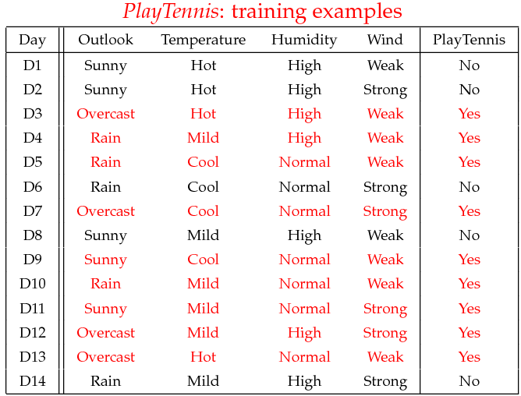
Tennis example

Slide 13
Tennis example
The learning phase
P(Play=Yes) = 9/14
P(Play=No) = 5/14
We have four variables, we calculate for each we calculate the conditional probability table
Outlook | Play=Yes | Play=No
Sunny | 2/9 | 3/5
Overcast | 4/9 | 0/5
Rain | 3/9 | 2/5
Temperature | Play=Yes | Play=No
Hot | 2/9 | 2/5
Mild | 4/9 | 2/5
Cool | 3/9 | 1/5
Humidity | Play=Yes | Play=No
High | 3/9 | 4/5
Normal | 6/9 | 1/5
Wind | Play=Yes | Play=No
Strong | 3/9 | 3/5
Weak | 6/9 | 2/5

Slide 14



The test phase for the tennis example
Given a new instance of variable values,
  $x^{′}$=(Outlook=Sunny, Temperature=Cool, Humidity=High, Wind=Strong)
Compute $P(Yes|x^{′})$ and $P(No|x^{′})$
Given calculated Look up tables
$$P(Outlook=Sunny|Play=Yes) = 2/9$$
$$P(Temperature=Cool|Play=Yes) = 3/9$$
$$P(Huminity=High|Play=Yes) = 3/9$$
$$P(Wind=Strong|Play=Yes) = 3/9$$
$$P(Play=Yes) = 9/14$$
$$P(Outlook=Sunny|Play=No) = 3/5$$
$$P(Temperature=Cool|Play==No) = 1/5$$
$$P(Huminity=High|Play=No) = 4/5$$
$$P(Wind=Strong|Play=No) = 3/5$$
$$P(Play=No) = 5/14$$

Slide 15

The test phase for the tennis example
Use the MAP rule to calculate Yes or No
$$P\left(Yes | x’\right):$$
$$\left[P\left(Sunny | Yes\right)P\left(Cool | Yes\right)P\left(High | Yes\right)P\left(Strong | Yes\right)\right]P\left(Play=Yes\right)=\frac{2}{9}×\frac{3}{9}×\frac{3}{9}×\frac{3}{9}×\frac{9}{14}=0.0053$$
$$P\left(No | x’\right):$$
$$\left[P\left(Sunny | No\right)P\left(Cool | No\right)P\left(High | No\right)P\left(Strong | No\right)\right]P\left(Play=No\right)$$
$$=\frac{3}{5}×\frac{1}{5}×\frac{4}{5}×\frac{3}{5}×\frac{5}{14}= 0.0206$$
Given the fact $P(Yes|x^{′}) < P(No|x^{′})$, we label $x^{′}$ to be $“No”$.

Slide 16
Issues Relevant to Naïve Bayes
1. Violation of Independence Assumption
2. Zero conditional probability Problem

Slide 17

Issues Relevant to Naïve Bayes
1. Violation of Independence Assumption
  For many real world tasks,
  Nevertheless, naïve Bayes works surprisingly well anyway!
$$P\left(x_{1},…,x_{d} | c_{i}\right)≠P\left(x_{1} | c_{i}\right)⋯P(x_{d}|c_{i})$$

Slide 18


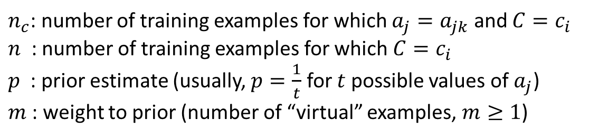

Issues Relevant to Naïve Bayes
2. Zero conditional probability Problem
  Such problem exists when no example contains the attribute value $a_{jk}$
  In this circumstance, $\hat{P}\left(x_{1} | c_{i}\right)⋯\hat{P}\left(a_{jk} | c_{i}\right)⋯\hat{P}\left(x_{n} | c_{i}\right)=0$ during test
  For a remedy, conditional probabilities are estimated with Laplace smoothing
$$a_{j}=a_{jk}→ \hat{P}\left(a_{j}=a_{jk} | {C=c}_{i}\right)=0$$
$$P\left(a_{j}=a_{jk} | C=c_{i}\right)=\frac{n_{c}+mp}{n+m}$$
$n_{c}$: number of training examples for which $a_{j}=a_{jk}$ and $C=c_{i}$
$n$ : number of training examples for which $C=c_{i}$
$p$ : prior estimate (usually, $p=\frac{1}{t}$ for $t$ possible values of $a_{j}$)
$m$ : weight to prior (number of “virtual” examples, $m≥1$)

Slide 19
Conclusion
Naïve Bayes is based on the independence assumption
  Training is very easy and fast; just requiring considering each attribute in each class separately
  Test is straightforward; just looking up tables or calculating conditional probabilities with normal distributions
Naïve Bayes is a popular generative classifier model
  Performance of naïve Bayes is competitive to most of state-of-the-art classifiers even if in presence of violating the independence assumption
  It has many successful applications, e.g., spam mail filtering
  A good candidate of a base learner in ensemble learning
  Apart from classification, naïve Bayes can do more…

Slide 20
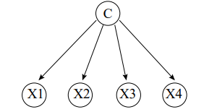

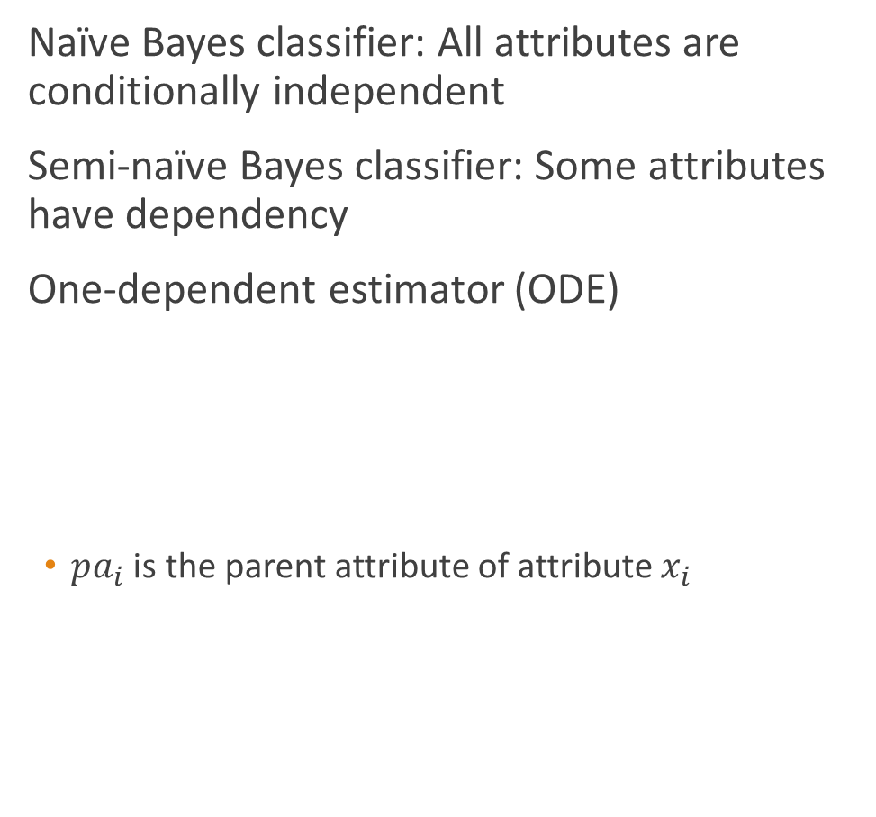
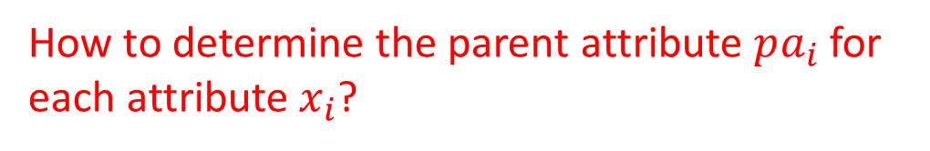
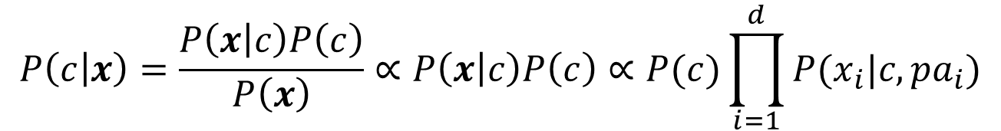
Semi-naïve Bayes classifier
Naïve Bayes classifier: All attributes are conditionally independent
Semi-naïve Bayes classifier: Some attributes have dependency
One-dependent estimator (ODE)
  $pa_{i}$ is the parent attribute of attribute $x_{i}$
$$P\left(c | x\right)=\frac{P\left(x | c\right)P\left(c\right)}{P\left(x\right)}∝P\left(x | c\right)P\left(c\right)∝P(c)\prod_{i=1}^{d}{P(x_{i}|c,pa_{i})}$$
How to determine the parent attribute $pa_{i}$ for each attribute $x_{i}$?

Slide 21
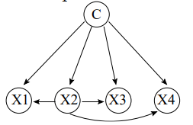

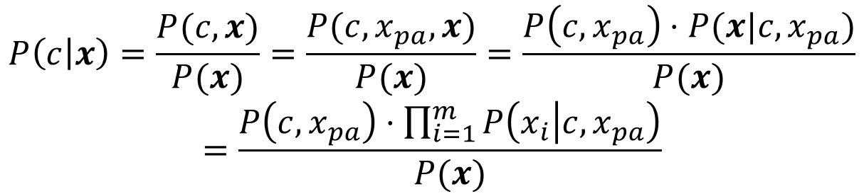
Semi-naïve Bayes classifier
A SPODE requires all attributes to depend on the same attribute, namely the superparent, in addition to the class
A SPODE with superparent $pa$ will estimate the probability of each class label $c$ given an instance $x$ as follows. Denote the value of $pa$ in $x$ by $x_{pa}$
$$P\left(c | x\right)=\frac{P(c,x)}{P(x)}=\frac{P(c,x_{pa},x)}{P(x)}=\frac{P\left(c,x_{pa}\right)⋅P(x|c,x_{pa})}{P(x)}$$
$$=\frac{P\left(c,x_{pa}\right)⋅\prod_{i=1}^{m}{P\left(x_{i} | c,x_{pa}\right)}}{P(x)}$$
For a SPODE, the class is the root and has no parents. The superparent has a single parent: the class. Other attributes have two parents: the class and the superparent.

Slide 22
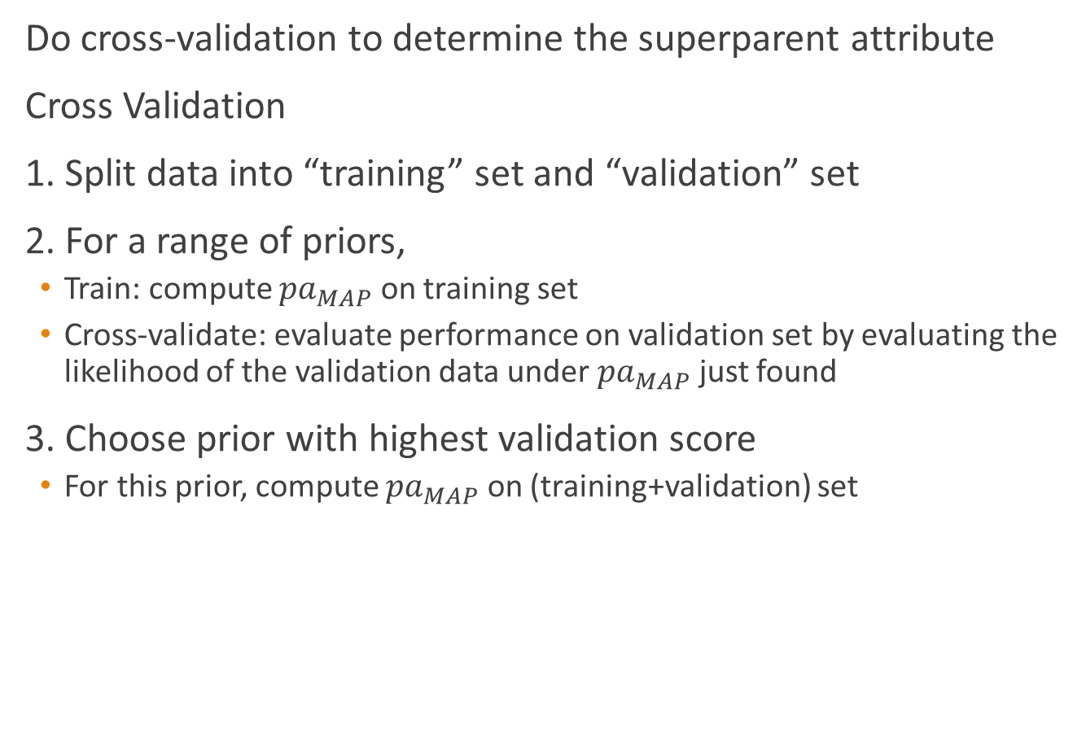
Semi-naïve Bayes classifier
Do cross-validation to determine the superparent attribute
Cross Validation
1. Split data into “training” set and “validation” set
2. For a range of priors,
  Train: compute ${pa}_{MAP}$ on training set
  Cross-validate: evaluate performance on validation set by evaluating the likelihood of the validation data under ${pa}_{MAP}$ just found
3. Choose prior with highest validation score
  For this prior, compute ${pa}_{MAP}$ on (training+validation) set

Slide 23
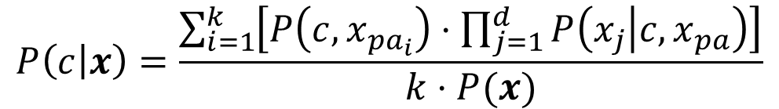
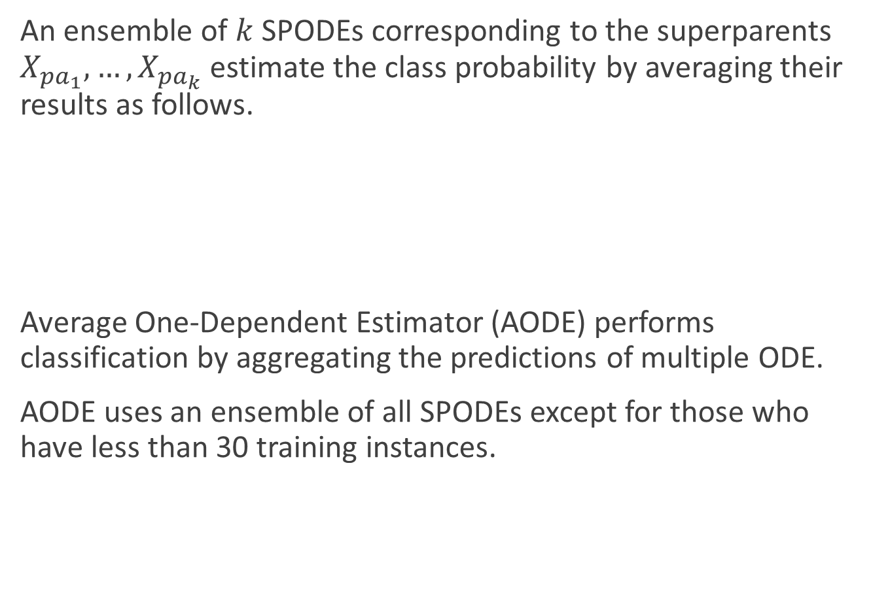
Semi-naïve Bayes classifier
An ensemble of $k$ SPODEs corresponding to the superparents $X_{{pa}_{1}},…,X_{{pa}_{k}}$ estimate the class probability by averaging their results as follows.
Average One-Dependent Estimator (AODE) performs classification by aggregating the predictions of multiple ODE.
AODE uses an ensemble of all SPODEs except for those who have less than 30 training instances.
$$P\left(c | x\right)=\frac{\sum_{i=1}^{k}{\left[P\left(c,x_{{pa}_{i}}\right)⋅\prod_{j=1}^{d}{P\left(x_{j} | c,x_{pa}\right)}\right]}}{k⋅P(x)}$$

Slide 24
Semi-naïve Bayes classifier
编号 | 色泽 | 根蒂 | 敲声 | 纹理 | 脐部 | 触感 | 好瓜
1 | 青绿 | 蜷缩 | 浊响 | 清晰 | 凹陷 | 硬滑 | 是
2 | 乌黑 | 蜷缩 | 沉闷 | 清晰 | 凹陷 | 硬滑 | 是
3 | 乌黑 | 蜷缩 | 浊响 | 清晰 | 凹陷 | 硬滑 | 是
4 | 青绿 | 蜷缩 | 沉闷 | 清晰 | 凹陷 | 硬滑 | 是
5 | 浅白 | 蜷缩 | 浊响 | 清晰 | 凹陷 | 硬滑 | 是
6 | 青绿 | 稍蜷 | 浊响 | 清晰 | 稍凹 | 软粘 | 是
7 | 乌黑 | 稍蜷 | 浊响 | 稍糊 | 稍凹 | 软粘 | 是
8 | 乌黑 | 稍蜷 | 浊响 | 清晰 | 稍凹 | 硬滑 | 是
9 | 乌黑 | 稍蜷 | 沉闷 | 稍糊 | 稍凹 | 硬滑 | 否
10 | 青绿 | 硬挺 | 清脆 | 清晰 | 平坦 | 软粘 | 否
11 | 浅白 | 硬挺 | 清脆 | 模糊 | 平坦 | 硬滑 | 否
12 | 浅白 | 蜷缩 | 浊响 | 模糊 | 平坦 | 软粘 | 否
13 | 青绿 | 稍蜷 | 浊响 | 稍糊 | 凹陷 | 硬滑 | 否
14 | 浅白 | 稍蜷 | 沉闷 | 稍糊 | 凹陷 | 硬滑 | 否
15 | 乌黑 | 稍蜷 | 浊响 | 清晰 | 稍凹 | 软粘 | 否
16 | 浅白 | 蜷缩 | 浊响 | 模糊 | 平坦 | 硬滑 | 否
17 | 青绿 | 蜷缩 | 沉闷 | 稍糊 | 稍凹 | 硬滑 | 否
西瓜数据集3.0

Slide 25


Semi-naïve Bayes classifier
$$\hat{P}\left(c,x_{pa_{i}}\right)=\frac{\left|D_{c,x_{pa_{i}}}\right|+1}{\left|D\right|+N_{i}}$$
$$\hat{P}\left(x_{j}|c,x_{pa_{i}}\right)=\frac{\left|D_{c,x_{pa_{i}},x_{j} }\right|+1}{\left|D_{c,{x_{pa}}_{i}}\right|+N_{j}}$$
$${\hat{P}}_{是,浊响}=\hat{P}\left(好瓜=是,敲声=浊响\right)$$
$$=\frac{6+1}{17+3}=0.350$$
$${\hat{P}}_{凹陷|是,浊响}=\hat{P}\left(脐部=凹陷|好瓜=是,敲声=浊响\right)$$
$$=\frac{3+1}{6+3}=0.444$$

Slide 26
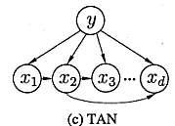
Semi-naïve Bayes classifier
Tree augmented naïve Bayes (TAN) relaxes the naive Bayes attribute independence assumption by employing a tree structure, in which each attribute only depends on the class and one other attribute. A maximum weighted spanning tree that maximizes the likelihood of the training data is used to perform classification.
In addition to the Naïve Bayes arcs (class to feature), we are permitted a directed tree among the features
Given this restriction, there exists a polynomial-time algorithm to find the maximum likelihood structure

Slide 27
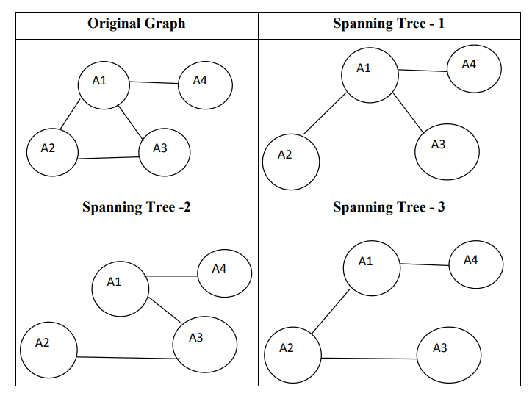
Semi-naïve Bayes classifier
A spanning tree of a graph is a subgraph that contains all the vertices and is generally represented as a tree.
A graph may have many spanning trees.

Slide 28

Semi-naïve Bayes classifier
The maximum cost of the spanning tree is the highest cost obtained among the costs computed for all spanning trees obtained from the graph.
If $st_{1},st_{2},…st_{k}$ are the spanning trees associated with a given graph $G$ and $c_{1}, c_{2},….c_{k}$ are the costs associated with the spanning tree’s, then maximum spanning tree $st_{max}$ is the spanning tree corresponding to $\max{\sum_{i=1}^{k}{c_{k}}}$.

Slide 29
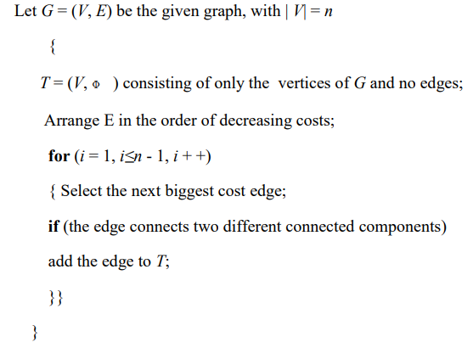
Semi-naïve Bayes classifier
Kruskal’s algorithm is a greedy algorithm which is used to design minimum/maximum spanning tree in a connected graph.
Other algorithms: Prim’s algorithm, Boravka’s algorithm, Dijkstra’s algorithm

Slide 30
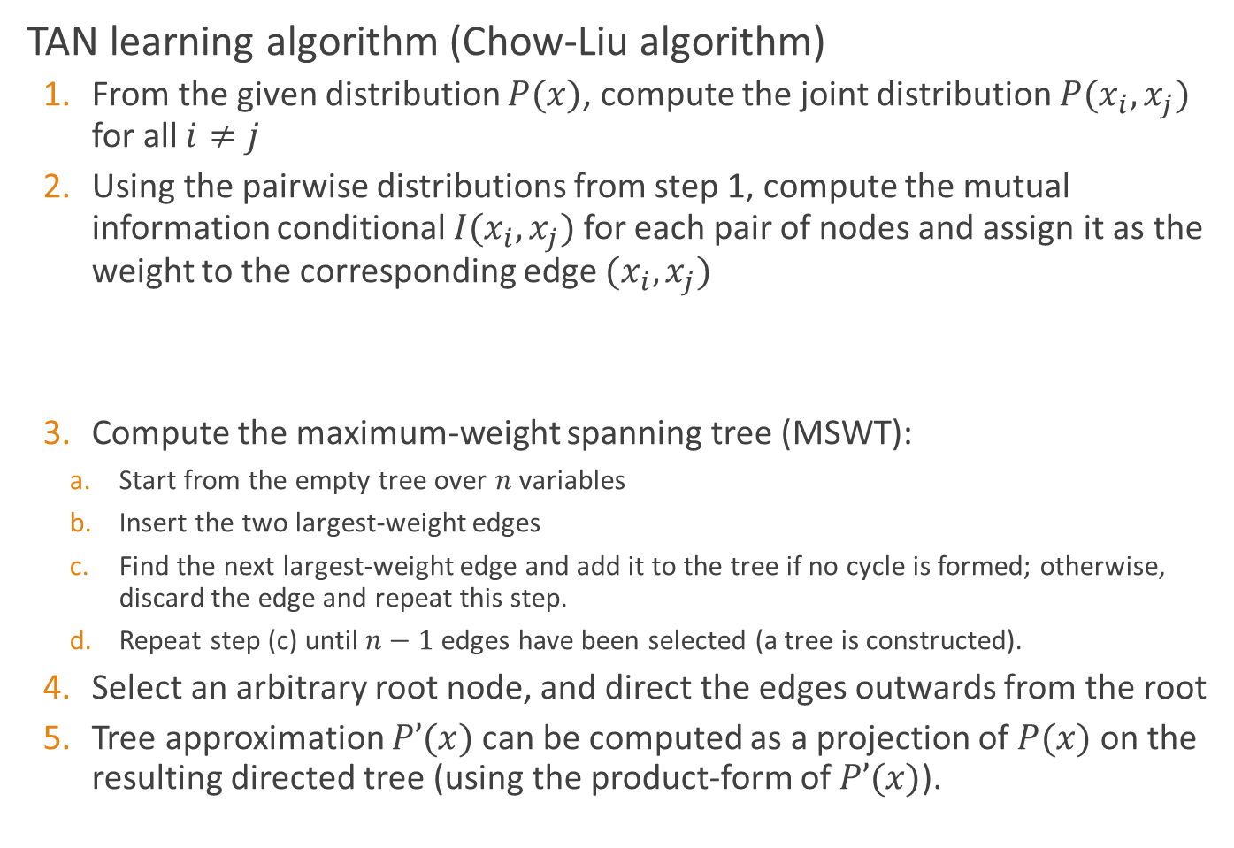
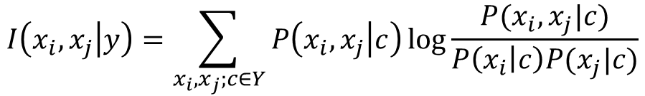
Semi-naïve Bayes classifier
TAN learning algorithm (Chow-Liu algorithm)
  From the given distribution $P(x)$, compute the joint distribution $P(x_{i},x_{j})$ for all $i≠j$
  Using the pairwise distributions from step 1, compute the mutual information conditional $I(x_{i},x_{j})$ for each pair of nodes and assign it as the weight to the corresponding edge $(x_{i},x_{j})$
  Compute the maximum-weight spanning tree (MSWT):
    Start from the empty tree over $n$ variables
    Insert the two largest-weight edges
    Find the next largest-weight edge and add it to the tree if no cycle is formed; otherwise, discard the edge and repeat this step.
    Repeat step (c) until $n−1$ edges have been selected (a tree is constructed).
  Select an arbitrary root node, and direct the edges outwards from the root
  Tree approximation $P’(x)$can be computed as a projection of $P(x)$on the resulting directed tree (using the product-form of $P’(x)$).
$$I\left(x_{i},x_{j} | y\right)=\sum_{x_{i},x_{j};c∈Y}{P\left(x_{i},x_{j} | c\right)\log{\frac{P(x_{i},x_{j}|c)}{P\left(x_{i} | c\right)P(x_{j}|c)}}}$$
Notes:
In probability theory and information theory, the mutual information (MI) of two random variables is a measure of the mutual dependence between the two variables. More specifically, it quantifies the "amount of information" (in units such as shannons, commonly called bits) obtained about one random variable through observing the other random variable.

Slide 31
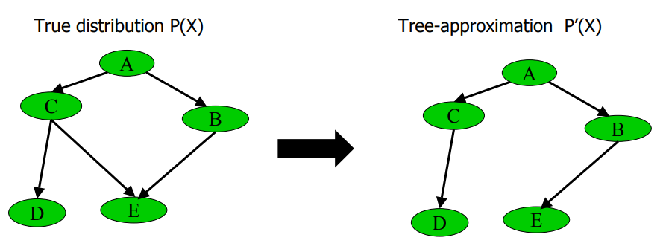
Semi-naïve Bayes classifier
This algorithm determines the best tree that links all the variables, using a mutual information measurement or the BIC score variation when two variables become linked
The aim is to find an optimal solution, but in a space limited to trees

Slide 32
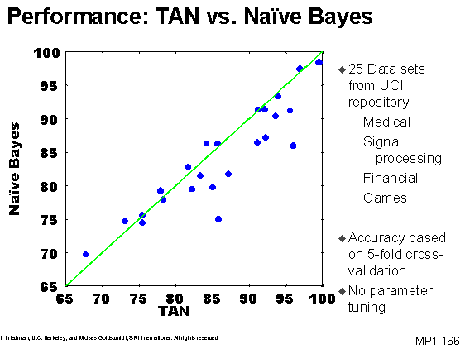
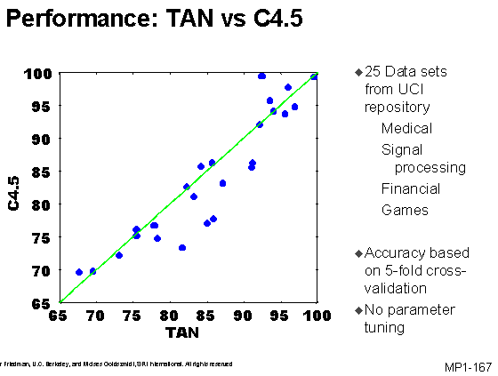
Semi-naïve Bayes classifier
(Slide comes from http://ai.stanford.edu/~moises/tutorial/img166.GIF)

Slide 33
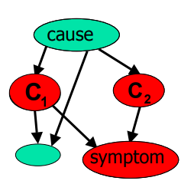
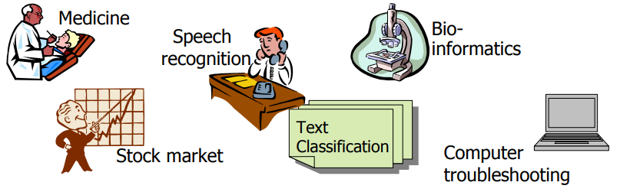

Bayesian network
Bayesian network (or belief network) uses Directed Acyclic Graph (DAG) to illustrate dependencies between attributes, and uses Conditional Probability Table (CPT) to describe the joint distribution of all attributes
What are BNs useful for?
  Diagnosis: $P(cause|symptom)=?$
  Prediction: $P(symptom|cause)=?$
  Classification: $\max_{class}⁡P(class|data )$
  Decision-making (given a cost function
Notes:
Slides are from: http://www.ee.columbia.edu/~vittorio/Lecture12.pdf

Slide 34






Bayesian network
A Bayesian network $B$ can be denoted by $B=\left\langle G,Θ\right\rangle$
  $G$ is a DAG with each node corresponding to an attribute
  If two attributes are not independent, there is an edge in $G$ connecting them together
  $Θ=\left\{θ_{x_{i}|π_{i}}\right\}, θ_{x_{i}|π_{i}}=P_{B}(x_{i}|π_{i})$. $π_{i}$ is a set consisting of all parent nodes of $x_{i}$
根蒂
$x_{1}$(好瓜)
$x_{2}$(甜度)
 | 硬挺 | 蜷缩
高 | 0.1 | 0.9
低 | 0.7 | 0.3
甜度
$x_{3}$(敲声)
$x_{4}$(色泽)
$x_{5}$(根蒂)

Slide 35



Bayesian network
Each node is independent of its non-descendants given its parents. The joint distribution of attributes $x_{1},x_{2},…,x_{d}$ can be written as
$$P_{B}\left(x_{1},x_{2},…,x_{d}\right)=\prod_{i=1}^{d}{P_{B}(x_{i}|π_{i})}=\prod_{i=1}^{d}{θ_{x_{i}|π_{i}}}$$
$$P\left(x_{1},x_{2},x_{3},x_{4},x_{5}\right)=P\left(x_{3},x_{4},x_{5} | x_{1},x_{2}\right)P\left(x_{1},x_{2}\right)$$
$$=P\left(x_{3},x_{4},x_{5} | x_{1},x_{2}\right)P\left(x_{1}\right)P\left(x_{2}\right)$$
$$=P\left(x_{1}\right)P\left(x_{2}\right)P\left(x_{3} | x_{1}\right)P\left(x_{4} | x_{1},x_{2}\right)P(x_{5}|x_{2})$$
$x_{1}$(好瓜)
$x_{2}$(甜度)
$x_{3}$(敲声)
$x_{4}$(色泽)
$x_{5}$(根蒂)

Slide 36













Conditional independence in BNs
Three types of connections
Marginal independence
$$x_{1}$$
$$x_{1}$$
$$x_{2}$$
$$x$$
$$x_{3}$$
$$x_{4}$$
$$x_{4}$$
$$y$$
$$z$$
Diverging
Converging
Serial
Knowing $x_{1}$: $x_{3}⊥x_{4}$ (common cause)
NOT knowing $x_{4}$ : $x_{1}⊥x_{2}$ (common effect)
Knowing $x$: $y⊥z$ (intermediate cause)
$$P\left(x_{1},x_{2}\right)=\sum_{x_{4}}{P(x_{1},x_{2},x_{4})}$$
$$=\sum_{x_{4}}{P\left(x_{4} | x_{1},x_{2}\right)P\left(x_{1}\right)P(x_{2})}$$
$$=P\left(x_{1}\right)P(x_{2})$$

Slide 37


Learning Bayesian networks
If structure is known, the learning process of a BN will be easy
  If we have a training set of complete observations
  Count training samples and estimate the conditional probability table for each node
  $P(X|Parents(X))$is given by the observed frequencies of the different values of $X$for each combination of parent values

Slide 38

Learning Bayesian networks
If structure is known, the learning process of a BN will be easy
  Incomplete observations
Expectation maximization (EM) algorithm for dealing with missing data

Slide 39


Learning Bayesian networks
However, the network structure is unknown
  Structure learning algorithms exist, but they are pretty complicated…
We will use scoring functions to rate each network. The one with the best score is “better.”
Given a training set $D=\{x_{1},x_{2},…x_{m}\}$, the scoring function of a BN $B=\left\langle G,Θ\right\rangle$ based on $D$ is
where
$$s\left(B | D\right)=f\left(θ\right)\left|B\right|−LL\left(B | D\right)$$
$$LL\left(B | D\right)=\sum_{i=1}^{m}{\log{P_{B}(x_{i})}}$$

Slide 40

Learning Bayesian networks
$\left|B\right|$ is the number of BN parameters
$f(θ)$ is the number of bits of each parameter
$LL(B|D)$ is the log likelihood of BN
We want to find a BN to minimize scoring function $s\left(B | D\right)$
If $f\left(θ\right)=1$: $AIC\left(B | D\right)=\left|B\right|−LL(B|D)$
If $f\left(θ\right)=\frac{1}{2}\log{m}$: $BIC\left(B | D\right)=\frac{\log{m}}{2}\left|B\right|−LL(B|D)$
$$s\left(B | D\right)=f\left(θ\right)\left|B\right|−LL\left(B | D\right)$$
$$LL\left(B | D\right)=\sum_{i=1}^{m}{\log{P_{B}(x_{i})}}$$
Notes:
$s\left(B | D\right)$第一项是计算编码贝叶斯网B所需的字节数；第二项是计算B所对应的概率分布$P_{B}$需要多少字节来描述D

Slide 41



Learning Bayesian networks
If $G$ is fixed, the first item in $s\left(B | D\right)$ is a constant. Then
And we have
$$\min{s\left(B | D\right)}⇒ \max{LL(B|D)}$$
$$θ_{x_{i}|π_{i}}={\hat{P}}_{D}(x_{i}|π_{i})$$
$$s\left(B | D\right)=f\left(θ\right)\left|B\right|−LL\left(B | D\right)$$
$$LL\left(B | D\right)=\sum_{i=1}^{m}{\log{P_{B}(x_{i})}}$$

Slide 42





Learning Bayesian networks
If graph structure is unknown, find
Heuristic search
  Complete data :local computations
  Incomplete data (score nondecomposable): stochastic methods
Constrained-based methods (PC/IC algorithms)
  Data impose independence relations (constraints) on graph structure
$$\hat{G}=\arg{\max_{G}{Score(G)}}$$
NP-hard optimization
Add C->B

Slide 43


Bayesian inference
The process of speculating unknown variables using values of observed variables is called inference
The ideal situation is to compute posterior probabilities $P(Q=q|E=e)$ using joint distribution defined in BN
  Query variables: $Q=q$
  Evidence (observed observed) variables: ) variables: $E = e$
Recall: inference via the full joint distribution
Exact inference is NP-hard (Actually #P-complete)
$$P\left(Q=q | E=e\right)=\frac{P(q,e)}{P(e)}∝P(q,e)$$

Slide 44

Approximate inference: Sampling
It’s difficult when BN structure is large
Using sampling methods to perform approximate inference
we denote the set $(X_{1}, . . ., X_{i−1,} X_{i+1}, . . ., X_{n})$as $X_{(−i)}$ , and $e = (e_{1}, . . . , e_{m})$. Then, the following method gives one possible way of creating a Gibbs sampler:
Initialize:
  (a) Instantiate $X_{i}$ to one of its possible values $x_{i} , 1 ≤ i ≤ n$.
  (b) Let $x^{(0)} = (x_{1},…,x_{n})$
For $t = 1, 2, …$
  Pick an index $i,1≤i≤n$ uniformly at random.
  Sample $x_{i}$ from $P(X_{i}|x_{\left(−i\right)}^{\left(t−1\right)},e)$
  Let $x^{(t)} = (x_{\left(−i\right)} , x_{i})$
Notes:
http://vision.psych.umn.edu/users/schrater/schrater_lab/courses/AI2/gibbs.pdf
Gibbs sampling is applicable when the joint distribution is not known explicitly, but the conditional distribution of each variable is known. The Gibbs sampling algorithm is used to generate an instance from the distribution of each variable in turn, conditional on the current values of the other variables. It can be shown that the sequence of samples comprises a Markov chain, and the stationary distribution of that Markov chain is just the sought-after joint distribution. Gibbs sampling is particularly well-adapted to sampling the posterior distribution of a Bayesian network, since Bayesian networks are typically specified as a collection of conditional distributions

Slide 45


Approximate inference: Sampling
Consider the inference problem of estimating $P\left(Rain\right|Sprinkler = true, WetGrass = true)$

Slide 46

Approximate inference: Sampling
Since $Sprinkler$ and $WetGrass$ is set to true, the Gibbs sampler draws samples from $P(Rain, Cloudy|Sprinkler = true, WetGrass = true)$.

Slide 47

Approximate inference: Sampling
Initialize:
  (a) Instantiate $Rain = true, Cloudy = true$
  (b) Let $q^{(0)} = (Rain = true, Cloudy = true)$
For $t = 1, 2, …$
  Pick a variable to update from $\{Rain, Cloudy\}$ uniformly at random.
  If $Rain$ was picked
  Sample $Rain$ from $P(Rain|Cloudy = {\left[value\right]}_{t−1}, Sprinkler = true, WetGrass = true)$
  Let $q^{\left(t\right)} = (Rain = {\left[value\right]}_{t} , Cloudy = {\left[value\right]}_{t−1})$
  Else
  Sample $Cloudy$ from $P(Cloudy|Rain = {\left[value\right]}_{t−1}, Sprinkler = true, WetGrass = true)$
  Let $q^{\left(t\right)}=(Cloudy = {\left[value\right]}_{t} , Rain = {\left[value\right]}_{t−1})$

Slide 48


Approximate inference: Sampling
For convenience, we denote $Sprinkler = true$by $s$, $WetGrass = true$ by $w$, $Rain = true$by $r$, $Rain = false$by $¬r$, $Cloudy = true$by $c$ and $Cloudy = false$by $¬c$
$P\left(¬c | r,s,w\right)=1−P\left(c | r,s,w\right)=0.6923$
The probabilities $P(c|¬r, s, w)$and $P(¬c|¬r, s, w)$can be similarly computed.

Slide 49


Approximate inference: Sampling
Also
$P(¬r|c, s, w) = 1−P(r|c, s, w) = 0.1852$
The probabilities $P(r|¬c, s, w)$ and $P(¬r|¬c, s, w)$can be similarly computed.

Slide 50


Approximate inference: Sampling
Suppose we drew $N$ samples from the joint samples from the joint distribution
How do we compute $P\left(Q=q | E=e\right)?$
Other approximate inference methods
  Belief propagation
$$P\left(Q=q | E=e\right)=\frac{P(q,e)}{P(e)}≈\frac{\# of times q and e happen}{\# of e happen}$$

Slide 51



EM algorithm
If there are latent variables, the set of which is denoted by $X$, in samples, how to estimate parameters in a generative model?
The objective function
Example:
Given data $z_{1},z_{2},…,z_{m}$ (but no $x_{i}$ observed)
Find maximum likelihood estimates of $μ_{1},μ_{2}$
$$LL\left(θ | X,Z\right)=\ln{P(X,Z|θ)}$$
$$P\left(X=1\right)=\frac{1}{2},P\left(X=2\right)=\frac{1}{2}$$
$$Z|X=1\sim 𝒩(μ_{1},1)$$
$$Z|X=2\sim 𝒩(μ_{2},1)$$

Slide 52

EM algorithm
EM basic idea: if $X$ were known $→$ two easy-to-solve separate ML problems
EM iterates over
  E-step: For $i=1,…,m$fill in missing data $x_{i}$ according to what is most likely given the current model $μ$
  M-step: run ML for completed data, which gives new model $μ$

Slide 53


EM algorithm
EM solves a Maximum Likelihood problem of the form
$θ$: parameters of the probabilistic model we try to find
$x$: unobserved variables
$z$: observed variables
$$\max_{θ}{\log{\int_{x}{p\left(x,z;θ\right)dx}}}$$

Slide 54

EM algorithm
$$\max_{θ}{\log{\int_{x}{p\left(x,z;θ\right)dx}}}=\max_{θ}{\log{\int_{x}{p\left(x,z;θ\right)\frac{q\left(x\right)}{q\left(x\right)}dx}}}$$
$$=\max_{θ}{\log{\int_{x}{\frac{p\left(x,z;θ\right)}{q\left(x\right)}q\left(x\right)dx}}}$$
$$=\max_{θ}{\log{E_{X\sim q}\left[\frac{p\left(X,z;θ\right)}{q\left(X\right)}\right]}}$$
$$≥\max_{θ}{E_{X\sim q}\log\left[\frac{p\left(X,z;θ\right)}{q\left(X\right)}\right]}$$
$$=\max_{θ}{\int_{x}{q\left(x\right)\log{p\left(x,z;θ\right)}dx}}$$
$$−\int_{x}{q\left(x\right)\log{q\left(x\right)}dx}$$
Jensen’s Inequality

Slide 55


The expected value of a function
Let $X$ be a random variable whose PDF is $q(x)$, and $g$ a function of random variable $X$.
The expected value of $q(x)$ is
$$E\left[g(X)\right]=\int_{x}{g\left(x\right)q\left(x\right)dx}≜E_{X\sim q}\left[g\left(X\right)\right]$$

Slide 56





Jensen’s inequality
Suppose $f$ is concave, then for all probability measures $q$ we have that:
$f\left(E_{X\sim q}\right)≥E_{X\sim q}\left[f\left(X\right)\right]$
with equality holding only if $f$ is an affine function
Illustration:
$$P(X=x_{1})= λ$$
$$P\left(X=x_{2}\right)= 1−λ$$
$$f(λx_{1}+\left(1−λ\right)x_{2})$$
$$λf\left(x_{1}\right)+\left(1−λ\right)f(x_{2})$$
$$E[X] =λx_{1}+\left(1−λ\right)x_{2}$$

Slide 57



EM algorithm
$$\max_{θ}{\log{\int_{x}{p\left(x,z;θ\right)dx}}}≥\max_{θ}{\int_{x}{q\left(x\right)\log{p\left(x,z;θ\right)}dx}}−\int_{x}{q\left(x\right)\log{q\left(x\right)}dx}$$
Jensen’s Inequality: equality holds when
is an affine function
This is achieved for $q\left(x\right)=p(x|z;θ)∝p\left(x,z;θ\right)$
$$f\left(x\right)=\log{\frac{p\left(x,z;θ\right)}{q(x)}}$$
EM Algorithm: Iterate
1. E-step: Compute $q\left(x\right)=p(x|z;θ)$
2. M-step: Compute $θ=\arg{\max_{θ}{\int_{x}{q\left(x\right)\log{p\left(x,z;θ\right)}dx}}}$

Slide 58

EM algorithm
M-step optimization can be done efficiently in most cases
E-step is usually the more expensive step
It does not fill in the missing data $x$ with hard values, but finds a distribution $q(x)$
Improvement in true objective is at least as large as improvement in M-step objective
M-step objective is upper bounded by true objective
M-step objective is equal to true objective at current parameter estimate

